Slide 1

A COMPARATIVE TRIP RATE ANALYSIS OF PETROL FILLING STATIONS WITH AND WITHOUT SIGNIFICANT RETAIL
MATTHEW HOGBEN, KENT COUNTY COUNCIL
Notes:
Good Afternoon everyone and welcome back from the lunch break.
I’m Matt Hogben from Kent County Council and I’m a member of the TRICS Board of Directors.
In this presentation I shall be speaking about some recent analyses undertaken by TRICS into trip rate differences at Petrol stations with and without significant retail elements. Over a number of years we have noticed within our Bureau Service and questions being submitted to us by users, that there was an interest in discovering if there was a difference between these two sub-categories of Petrol Stations.

Slide 2
BACKGROUND
Aim of Technical Note: To compare the trip rate data across the two sub-categories
Technical Note does not provide reasoning behind the results, but should be used as a point of reference.
Practitioners can use their own professional judgement to interpret the results.
TRICS Contains a large number of surveys within the Petrol Filling Station Land Use.
13/A Petrol Filling Station
13/B Petrol Filling Station with Retail
Traffic only analysis and multi-modal analysis.
Notes:
So here is some background to this project.
As you will all be aware, the TRICS database contains a large number of surveys covering the Petrol Filling Station Land Use. This Land Use is split into 2 sub-categories, Petrol Filling Station and Petrol Filling Station with Retail and the aim of this analysis is to compare the trip rates for each of these two sub-categories.
Firstly: This technical note does not to provide any reasoning for the results obtained. But is intended to provide TRICS Users with a clear understanding of the comparison between the Petrol Filling Station Sub-Categories and for this information to be interpreted by practitioners using their own professional judgement.
The Petrol Station Land use is still very popular with Users and is still high on the list of required surveys from our Annual User Survey. Therefore, we ensure that both sub-categories are considered within our Annual Data Collection Programme to make sure that this land use data is collected and added to the database on a regular basis.
Petrol Filling Stations have changed considerably since the beginning of the TRICS system. With larger and larger retail elements becoming more and more popular. The 13/B sub-category was added into the system when we started to notice that larger retail elements were becoming more common amongst these facilities and required the existing data set to be split.
Since 2000 multi-modal surveys were introduced into the TRICS Database, and surveys at this Land Use have continued to have surveys of both Vehicle Only and Multi-modal being undertaken.

Slide 3
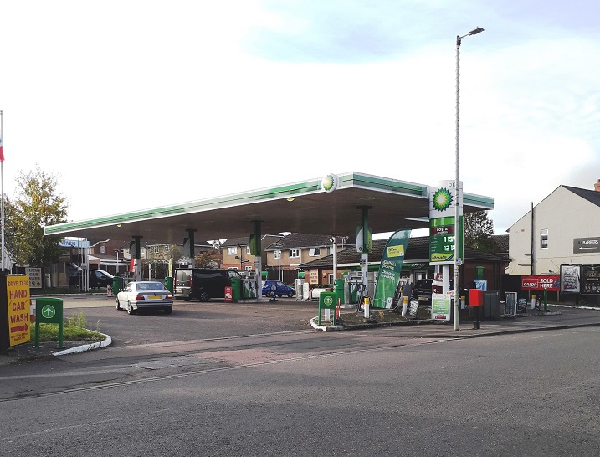
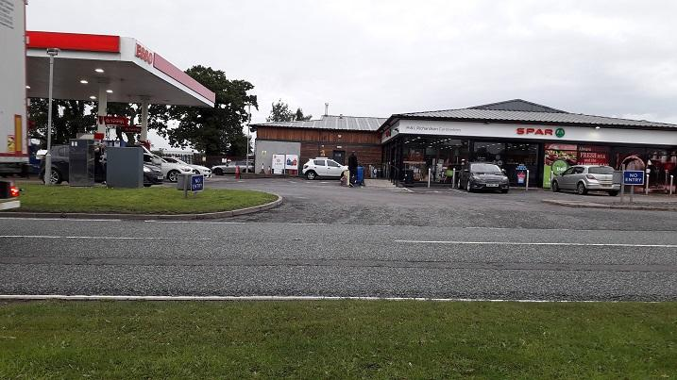
DEFINITIONS
13/A – Petrol Filling Stations
“Traditional” petrol filling station with a small shopping element such as a newsagent-type store.
13/B – PFS with Retail
Petrol filling station with a significant retail element, possibly a smaller version of a branded supermarket or an extended store run by the PFS company
In both cases trip rates can be calculated by Site Area or by Filling bays
Notes:
It is important to be clear upon the definitions used within TRICS to understand the difference between the two sub-categories of Petrol Station.
13/A Petrol Filling Stations- The definition on the slide is clear, but in essence it is the Traditional style of Petrol Station that has a small amount of retail, typically catering for newspapers and snacks as well as ‘on the road’ vehicle spares, such as bulbs and washer fluids etc.
13/B Petrol Filling Station with Retail - The main difference between the two categories is the size of the retail element. As you can hopefully see from the pictures, the example shown has a much larger retail area, similar to a small supermarket, that caters for a small basket shop, so stocking items such as fresh veg, ready meals, a large selection of drinks (including alcohol) and toiletries etc, as well as the usual snack and spares for drivers.
The trip rates for both sub-categories can be calculated by Site Area or Filling Bays

Slide 4
SURVEY SAMPLES
Important to ensure that enough surveys were available to create a robust data set
Selection Criteria:
  All surveys undertaken after 01/01/2000
  Data split into 2 date ranges 2000-2009 and 2010 onwards
  Analysis split into Weekday (Mon-Fri) & Weekend (Sat-Sun)
  Location types – Suburban, Edge of Town and Neighbourhood Centre (excluding villages)
Notes:
At the outset it was important to ensure that the database contained enough surveys for both sub-categories, to allow a robust comparison to be made. This meant that the selection process could not be overly restrictive. For this reason the selection criteria was chosen as follows:
All Petrol Station surveys since 1st January 2000 were used within the analysis
To enable comparisons over time this data was split into the 2 date ranges 2000 to 2009 and 2010 onwards. These 2 sets were also combined to give an additional comparison set.
The analysis was split into weekdays and weekends
And the Location types of Suburban, Edge of Town and Neighbourhood Centre (Excluding Villages) were used. These locations give the largest compatible group that would give the biggest dataset. The ‘TRICS Good Practice Guide’ outlines in more detail the various TRICS location types that are considered compatible with each other.

Slide 5
SURVEY SAMPLES
TRICS Land Use Sub-Category | 2000-2021* |  | 2000-2009 |  | 2010-2021
 | Mon-Fri | Sat-Sun | Mon-Fri | Sat-Sun | Mon-Fri | Sat-Sun
13/A (Petrol Filling Station) | 40 | 15 | 24 | 11 | 16 | 4
13/B (PFS with Retail) | 64 # | 39 | 30 | 19 | 35 | 20
Total | 104 | 54 | 54 | 30 | 51 | 24
*The survey sample for 13/A ends in 2020, whilst the sample for 13/B ends in 2021 (availability of data, not an intent in the selection process).
# Discrepancy (64 surveys does not equal the sum of the 30 and 35 surveys) is due to TRICS survey inclusion rules for re-surveys and is not an error).
Notes:
This slide shows the number of sites within each Date Range and Sub-Category
[CLICK] The asterisk beside the header 2000-2021 full date range shows that the 13/A category has data up to, and including 2020; with the 13/B category up to and including 2021. This is due to the available data within the system and not an intended part of the selection process
[CLICK] The hash beside the 64 in the first column of data also draws your attention to the fact that the combine date range of 2000 to 2021 has 64 sites for the weekday,
[CLICK] whilst the separated date ranges of 2000 to 2009 and 2010 to 2021 have 30 an 35 respectively. This is a perceived error, as 30 plus 35 are 65 not the 64 as stated. However, this is due to the fact that one site had been resurveyed between the two time periods, so can only be included the once when looking at the larger 2000-2021 date range, thus avoiding double counting of that site’s data.
As you can see we have a good spread of data across the various sub-categories and date ranges.
[CLICK] It is recognised that there is one particularly small dataset of 4 sites, that being 13/A Weekend between 2010 and 2021. But this was not considered significantly low enough to become an issue when undertaking the analysis.

Slide 6
METHOD OF ANALYSIS
Method Used:
  Trip Rates calculated per filling bay
  Total Vehicle Trip Rates used within analysis
  Total Trip Rates (combined Arrivals & Departures)
  Time Periods – 0700-1000, 1600-1900 and 0700-1900 also total survey period
  Trip Rates also shown for peak hour (total two-way)
Notes:
Now we have decided we have a good sample size, we move onto the Analysis. The method of analysis includes:
All trip rates were calculated using the Filling Bays option, meaning all trip rates produced for this report are expressed per 1 filling bay. We have found that this is the most common parameter used when looking at the Petrol Filling Station Land Use
Total Vehicle Trip Rates are used with the analysis, so this would include the 7 standard TRICS Vehicle classifications of (Car, Taxi, Motorcycle, Light Goods, Public Service Vehicles and the 2 OGV classes).
Total Trips are used, which is the combined Arrivals and Departures. As trips for Petrol Filling Stations are usually brief in nature it can be assumed that halving the figures within the report would likely be a good representation of a one-way flow, either Arrivals or Departures
Time periods of 7am to 10am, 4pm to 7pm and 7am to 7pm are used as well as the full survey period, this is usually 7 to 7, but in some cases may be longer
The analysis will also report upon the actual peak hour for the total two-way information.
It is acknowledged that the AM and PM periods chosen are considered more relevant for the weekday information than for the weekend, due to commuter peaks. However, it was decided to maintain consistency across all days so that comparisons can be made between Weekday and Weekend data.

Slide 7
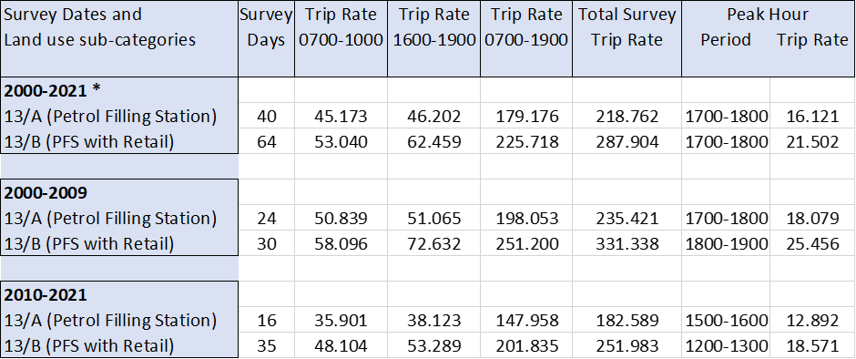
COMPARATIVE RESULTS - WEEKDAY
Notes:
We now move on to the Comparative Results.
As previously pointed out, TRICS does not intend to provide any explanations, suggestions or reasoning behind the comparative results that have been obtained through this technical analysis. Therefore, any speculative conclusions to be drawn from the results presented in this technical note will be down to the professional judgement of practitioners, and will not be the opinion of TRICS Consortium Limited.
However, we can provide some technical observations that may allow such a process to take place
This slide shows the results of the comparison between Petrol Filling Stations with and without significant retail for the weekday periods, for the three date ranges.
[CLICK] As you can see the ‘with retail’ sub-category has a larger Trip Rate per filling bay in all time periods and year ranges, in some cases quite considerable.
[CLICK] It can be seen that the 2010 to 2021 trip rates are lower that their 2000 to 2009 counterparts
[CLICK] You will also note that the trip rates for the Traditional Petrol Stations are reasonably consistent between the two peaks, those being 50.8 for the AM and 51.1 for the PM for 2000 to 2009; and 35.9 for the AM and 38.1 in the PM for 2010 to 2021.
[CLICK] Whereas the differences are more pronounced with the PFS with Retail, whose Trip Rates are 58.1 for the AM and 72.6 for the PM for 2000 to 2009; and 48.1 for the AM and 53.3 for the PM for 2010 to 2021.

Slide 8
COMPARATIVE RESULTS - WEEKEND
Notes:
This slide shows the results of the comparison between Petrol Filling Stations with and without significant retail for the weekend periods.
[CLICK] Again, very similar to what was seen with the weekdays, The ‘With Retail’ sub-category being greater than the standard petrol station.
[CLICK] The trip rates can again be seen to drop in 2010 to 2021 when comparing similar time periods with the same sub-category to that of 2000 to 2009
[CLICK] However, the trip rates for the Traditional Petrol Stations are less consistent between the two peaks, those being 28.7 for the AM and 38.1 for the PM for 2000 to 2009; and 21.3 for the AM and 25 in the PM for 2010 to 2021.
[CLICK] Whereas the differences are more pronounced with the PFS with Retail, whose Trip Rates are 46.2 for the AM and 85.9 for the PM for 2000 to 2009; and 32.7 for the AM and 49.2 for the PM for 2010 to 2021.

Slide 9
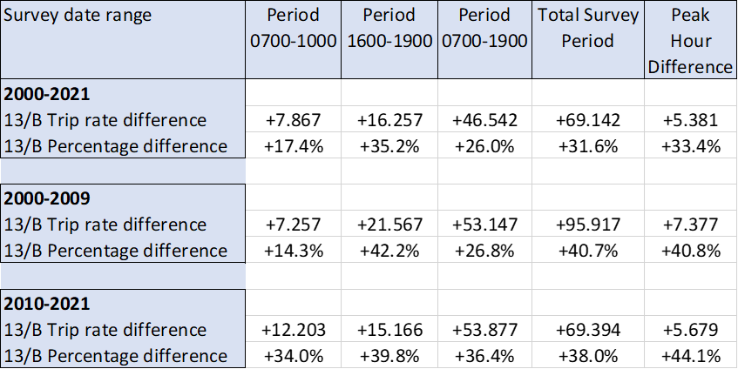
OBSERVATIONS - WEEKDAY
Notes:
What are the observations regarding this data.
This slide shows the actual differences in Trip Rate and the percentage change between 13/A and 13/B for the Weekday results.
You can see from the figures contained within this table how much the trip rate per filling bay for the 13/B sub-category differs from the 13/A standard filling station, this is also expressed as a percentage.
[CLICK] Just picking out a few examples here, the trip rates per filling bay for the period 2000 to 2009 for the filling stations with significant retail are 14.3% higher than standard filling stations over the same 7am to 10am time period.
[CLICK] This increases to 42.2% in the 4pm to 7pm time period.
[CLICK] Where as for the period 2010 to 2021 there seems to be a flatter percentage increase across the time periods. With 34% in the 7am to 10 am
[CLICK] and 39.8% in the 4pm to 7pm time period.
As you can see, quite significant differences across the board.
[CLICK] If you consider the 12 hour period 7am to 7pm, that’s around 53 to 54 additional trips per filling bay for the 12 hour period during the day. As you can see, quite a difference when you consider the number of filling bays that can be found at these facilities.

Slide 10
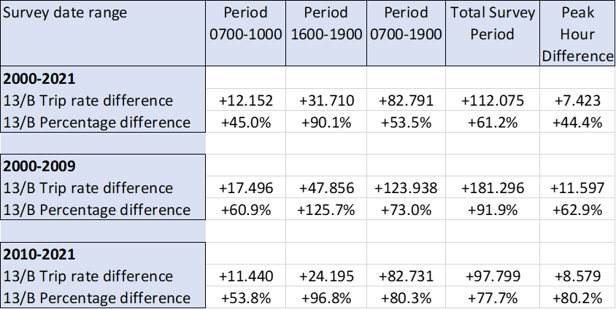
OBSERVATIONS - WEEKEND
Notes:
Here we have a similar tale for the Weekend results.
[CLICK] A few more examples here, the trip rates per filling bay for the period 2000 to 2009 for the filling stations with significant retail are 60.9.4% higher than standard filling stations over the 7am to 10am time period.
[CLICK] This increases to 125.7% in the 4pm to 7pm time period.
[CLICK] Where as for the period 2010 to 2021 there doesn’t see to be a flattening in the percentage increase across the time periods as observed with the weekday analysis. With 53.8% in the 7am to 10 am
[CLICK] and 96.8% in the 4pm to 7pm time period.
Again very significant differences.

Slide 11
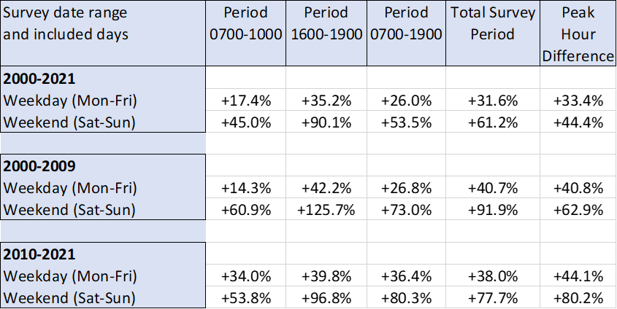
OBSERVATIONS – COMPARISON OF WEEKDAY AND WEEKEND PERCENTAGES
Notes:
This table takes the percentage increases for both Weekday and Weekends so that we can see if there are any patterns arising from the analysis.
[CLICK] It can be seen that the observed percentage increases at the weekend are greater than the weekday ones across all time periods and years of assessment
[CLICK] Also the 4pm to 7pm period is has a larger difference than the 7am to 10am period. When comparing similar time periods and years of assessment
However, there are no real emerging patterns as such, as the figures appear to be quite different between time periods and years of assessment.

Slide 12
WHAT HAS BEEN LEARNED?
Desktop Study shows an increase in Trip Rates per Filling Bay for sites with a significant retail element.
The change in Trip Rate differs between years of assessment and Time Period.
2010 to 2021 figures appear to have less of an increase than the previous 10 years. However, the increases are still significant.
4pm to 7pm figures appear larger when compared to the same assessment years for 7am to 10am.
Full Technical Note is available within the database (Library module).
Notes:
What has been learnt from undertaking this piece of analysis:
This work was undertaken to reflect upon questions raised by our users as to whether the provision of a significant retail element at Petrol Filling Stations actually made a difference in Trip Rates.
This desk top study, using the information we have available within the TRICS Database, has revealed that trip rates per filling bay are increased by the inclusion of a significant retail element
The changes seen differ between the years of assessment and the time periods
The level of increase between 2010 to 2021 appear to be less than the previous 10 years, but they are still all significant.
And the PM Period figures are increasing more when compared to the AM.
The full Technical Note is available within the Library module of TRICS.

